Slide 1

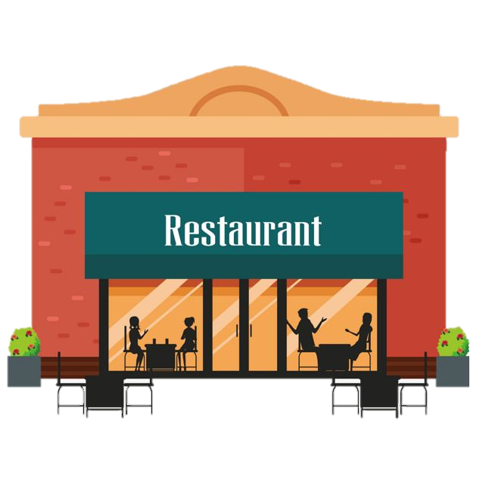
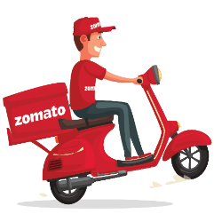
Zomato Restaurants Analysis
By :- Milin Rao Deshmukh

Slide 2
Agenda
Develop a Zomato restaurant expansion strategy based on data from 2010 to 2018, identifying potential countries and states for successful business growth and market opportunities.

Slide 3
Understanding Zomato's Business Model
Zomato is a global restaurant chain offering a variety of cuisines based on local tastes. It provides online table booking and food delivery services in many countries, enhancing the dining experience for customers.

Slide 4
Key Data Overview
The dataset we have from Zomato restaurants :-
Restaurant ID & Name: Unique IDs and names of each restaurant.
Location: Information about the country, city, and specific address.
Cuisines: Types of food offered.
Booking & Delivery: Availability of table booking and online delivery services.
Pricing & Ratings: Average cost for two diners and customer ratings.
This data helps us analyse restaurant choices and identify potential areas for expansion.

Slide 5
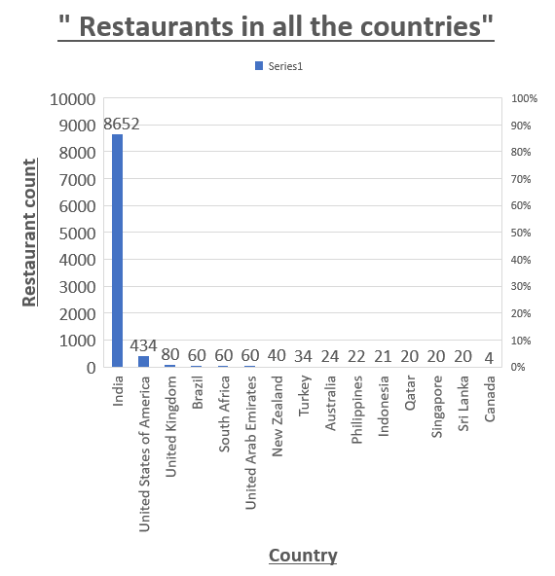
Key factors
Restaurants of Countries :-
Insights: High customer ratings in Philippines, Indonesia, UAE, and New Zealand highlight these as strong markets with potential, while India’s large restaurant count suffers from lower average ratings.
Recommendation: Prioritize expansion in high-rating countries while implementing quality improvements in India to enhance customer satisfaction and leverage the vast market potential.

Slide 6
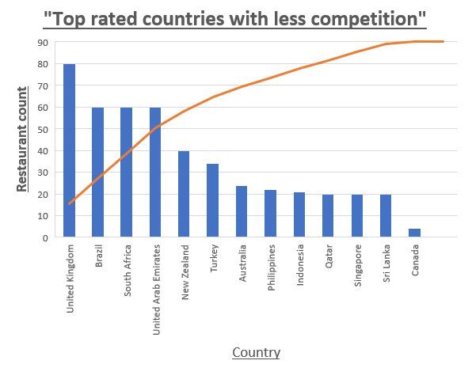
Key factors
2. Competition (Country):-
A lower restaurant count shows higher opportunity and less competition.
Rating from higher to lower will gone reflect customer satisfaction.
Here we can clearly see that Philippines, Indonesia and Qatar is the countries that having lower competition with higher customer satisfaction.

Slide 7
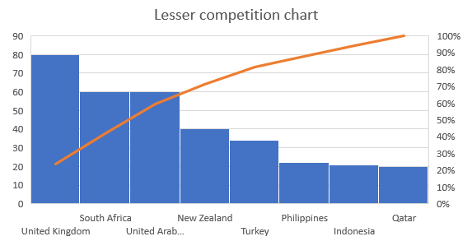
Key factors
3. Quality (Customer satisfaction):-
Rating from higher to lower will gone reflect customer satisfaction, which will helping to prioritize markets with the most positive feedback about us.
The Philippines has the highest rating of 4.47, showing excellent satisfaction. Indonesia's 4.29 is also impressive, and Qatar's 4.06 reflects a positive reception, although slightly lower.
Rating
Row Labels | Count of RestaurantID | Average of Rating
Indonesia | 21 | 4.295238095
Philippines | 22 | 4.468181818
Qatar | 20 | 4.06

Slide 8
Key factors
4. Investment:-
Insights: Indonesia has the lowest average cost for two at $18, followed by Qatar at $61. The Philippines has the highest cost, with an average of $117 for two, indicating higher expenses.
Recommendation: To minimize initial investment, it’s advisable to prioritize opening in Indonesia and Qatar, where costs are lower. The Philippines may be considered later due to its higher expenses. This helps guide financial planning and control initial investments in these countries.

Slide 9
Key factors
5. Cuisine analysis:-
Insights: The top-rated cuisines in the Philippines include European, Asian, Indian, and Japanese, Sushi, all rated 4.9. In Indonesia and Qatar, Sunda, Indonesian, and Sushi, Japanese also hold a perfect 4.9 rating, reflecting their popularity.
Recommendation: Focusing on Sushi, Japanese, and Sunda cuisines in Indonesia and Qatar, along with European, Asian, and Indian in the Philippines, is likely to yield better feedback and customer satisfaction, boosting overall ratings. This analysis will help in choosing the best cuisines for our new restaurants.
List of top 6 Cuisine
Country | Cuisine | Rating
Philippines | European, Asian, Indian | 4.9
Philippines | Japanese, Sushi | 4.9
Indonesia | Sunda, Indonesian | 4.9
Indonesia | Sushi, Japanese | 4.9
Qatar | Sunda, Indonesian | 4.9
Qatar | Sushi, Japanese | 4.9

Slide 10
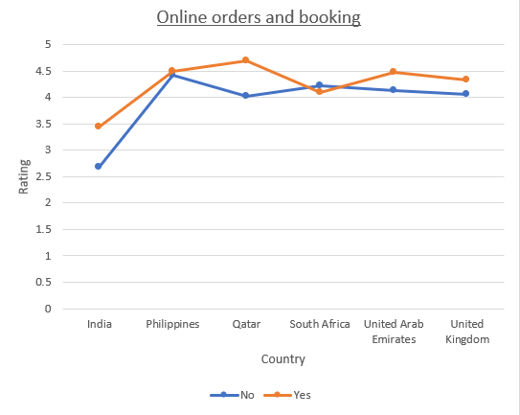
Key factors
6. Online booking and delivery analysis:-
Insights: Restaurants in India with online delivery and table booking have a higher average rating of 3.4, compared to 2.67 for those without these services. This trend is consistent across other regions, where providing these facilities correlates with better customer ratings.
Recommendation: To improve customer satisfaction and ratings, it's crucial to offer online delivery and table booking in our new restaurants. These services enhance the overall experience, leading to higher ratings and competitive advantage. The goal was to assess the impact of these facilities on restaurant ratings and customer satisfaction across various countries, including India.

Slide 11
Strategy
Customer Satisfaction: Higher ratings reflect better customer experiences at restaurants.
Demand Insights: A low number of restaurants combined with high voter turnout indicates strong demand and less competition.
Rating Analysis: Sort restaurants by their ratings, from highest to lowest, to understand customer preferences.
Growth Opportunities: Recommend cities in targeted countries with high ratings for potential business expansion.
Service Influence: Examine how online delivery and booking options impact restaurant ratings.

Slide 12
Insights
Recommended Countries: Philippines (4.47 rating), Indonesia (4.29 rating), and Qatar (4.06 rating) show high customer satisfaction with fewer restaurants, indicating less competition.
Recommended Cities for Expansion: Philippines (Quezon City, 4.8 rating), Indonesia (Jakarta, 4.36 rating), Qatar (Doha, 4.06 rating).
Strong Ratings: The Philippines has the highest average rating of 4.47, followed closely by Indonesia and Qatar, indicating positive customer experiences.
Service Impact: Restaurants offering online delivery and booking generally receive higher ratings than those that do not.
Expansion Suggestion: New restaurants should include online delivery and booking options to boost customer satisfaction.

Slide 13
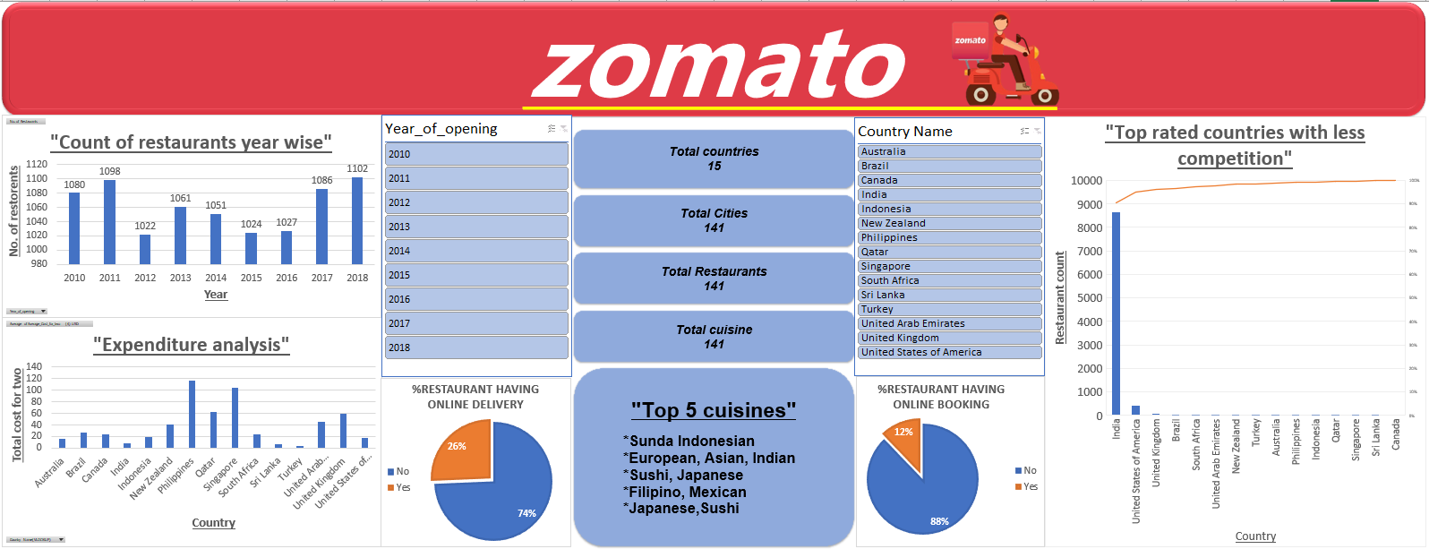
Dashboard
Dashboard

Slide 14
Conclusion
In summary, our analysis highlights that the Philippines, Indonesia, and Qatar present significant opportunities as promising markets for restaurant expansion due to high customer satisfaction and low competition. Implementing online delivery and booking services can further enhance customer experiences and drive profitability in these markets.

Slide 15
Thank you

